Slide 1

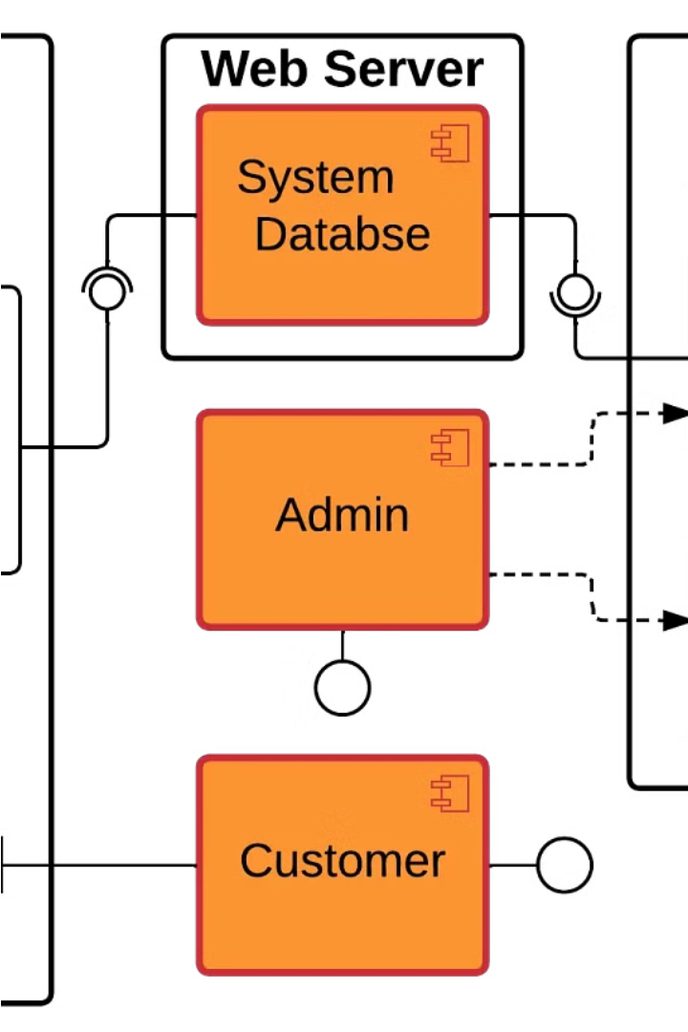
Designing ER Diagrams for Booking and Reservation Systems
This platform offers a comprehensive booking and reservation system that caters to all aspects of managing bookings, payments, and user interactions. Users can easily register and browse through available services, utilizing features such as reviews to inform their choices.
With capabilities like invoice generation, monitoring payment records, and personalized notifications, the system ensures a seamless experience for both users making reservations and managers overseeing them. In essence, it fosters a user-friendly environment for all involved in the booking process.
pa
By Goutam Kuiri

Slide 2

Booking and Reservation Systems Features
1
User Management
Secure registration, login, and profile management.
Access to booking history for users.
2
Service Management
Comprehensive service listings with search and filtering options.
Detailed service descriptions and pricing.
3
Booking Management
Easy booking creation, modification, and cancellation.
Real-time status updates and notifications for bookings.
4
Review and Rating System
User reviews and ratings for services.
Moderation tools for review quality control.

Slide 3

5
Location Management
Listing of service locations with search functionality.
6
Payment Processing
Secure payment gateway integration with multiple payment options.
Payment history tracking for users.
7
Cancellation and Refund Management
User-friendly process for cancellations and refunds.
Efficient handling and communication of cancellation/refund status.
8
Invoice Generation and Management
Automatic invoice generation for completed bookings.
Storage and tracking of invoices for users.
9
Notification System
Delivery of notifications for booking confirmations and updates.
Personalization options for notification preferences.
5

Slide 4
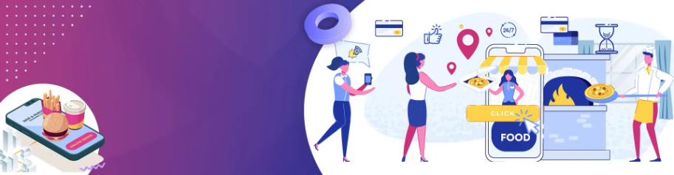

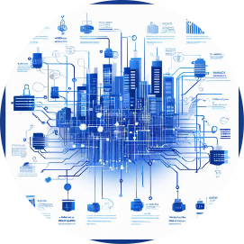
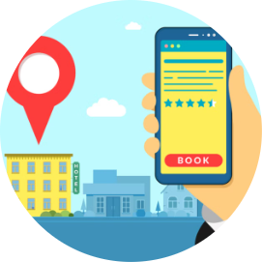
Entities and Attributes for Booking and Reservation Systems
Users
Services
Bookings
The User entity stores information about registered users, including their UserID (primary key), Name, Email, and Phone.
The Services entity contains details about the available services, such as ServiceID (primary key), Name, Description, and Price.
The Bookings entity tracks the details of each booking, including BookingID (primary key), UserID (foreign key), ServiceID (foreign key), Date, and Status.

Slide 5




Expanding the ER Diagram
Locations
Reviews
Payments
The Locations entity stores information about the service locations, including LocationID (primary key), Name, Address, City, and Country.
The Reviews entity captures user feedback, with ReviewID (primary key), UserID (foreign key), ServiceID (foreign key), Rating, and Comment.
The Payments entity records the details of each transaction, including PaymentID (primary key), BookingID (foreign key), Amount, PaymentDate, and PaymentMethod.

Slide 6




Handling Cancellations and Refunds
Cancellation/Refund
Invoices
Notifications
The Cancellation/Refund entity tracks the details of booking cancellations and refunds, including CancellationRefundID (primary key), BookingID (foreign key), CancellationDate, and RefundAmount.
The Invoices entity stores information about the generated invoices, including InvoiceID (primary key), UserID (foreign key), BookingID (foreign key), Amount, and Date.
The Notifications entity handles the delivery of booking-related notifications to users, including NotificationID (primary key), UserID (foreign key), and Message.

Slide 7

Relationships Between Entities
1.User – Bookings Relationship
A single user can make multiple bookings, establishing a "one-to-many" relationship.
Each booking is linked to one specific user, ensuring that the system can easily trace who made a particular reservation.
This connection enables efficient tracking of users' booking history and preferences within the system..
2.Services – Bookings Relationship
A service can be booked multiple times, forming a "one-to-many" relationship.
Each booking corresponds to a particular service.
This association allows the system to connect bookings with the specific services users have reserved.
3.Users – Reviews Relationship
A single user can write multiple reviews, establishing a "one-to-many" relationship.
Each review is authored by one user.
This linkage enables the system to attribute reviews to the users who submitted them, facilitating user feedback management.
4.Services – Reviews Relationship
A service can receive multiple reviews, forming a "one-to-many" relationship.
Each review is tied to a specific service.
This connection enables users to provide feedback for the services they have used, enhancing the system's review functionality.

Slide 8
5.Services – Location Relationship
Multiple services can be offered at a single location, creating a "many-to-one" relationship.
Each service is situated at a specific location.
This association highlights where services are available, assisting users in locating services based on their preferred locations.
6.Bookings -Payment Relationship
Every booking is paired with one payment, establishing a "one-to-one" relationship.
Each payment is specifically linked to one booking.
This connection enables the system to correlate bookings with the corresponding payments made by users, simplifying the tracking of financial transactions.
7.Bookings – Cancellation/Refund Relationship
Each booking is linked to one cancellation or refund record, forming a "one-to-one" relationship.
Correspondingly, each cancellation or refund record is tied to one specific booking.
This association empowers the system to effectively handle cancellation and refund procedures for bookings, keeping track of essential details like cancellation dates and refund amounts.
8.User – Payment Relationship
A user can make multiple payments, establishing a "one-to-many" relationship.
Each payment is executed by a single user.
This setup allows users to conduct multiple transactions while ensuring that each payment is associated with a specific user.

Slide 9
9.Users – Invoices Relationship
A single user can possess multiple invoices, indicating a "one-to-many" relationship.
This relationship signifies that a single user may have multiple invoices associated with their account.
10.Users – Notifications Relationship
Users can receive multiple notifications, representing a "one-to-many" relationship.
This means that a user may get various notifications from the system, such as booking confirmations or updates on service availability.

Slide 10
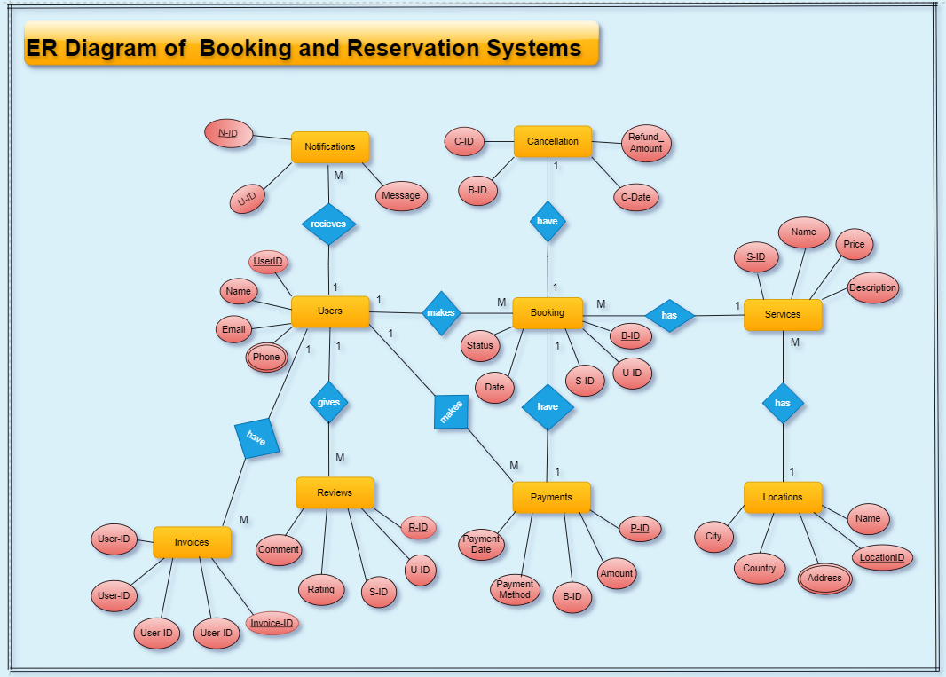
ER Diagram of Booking and Reservation Systems

Slide 11
Entities in SQL Format
CREATE TABLE Users (
UserID INT PRIMARY KEY,
Name VARCHAR(255),
Email VARCHAR(255),
Phone VARCHAR(20)
);
CREATE TABLE Services (
ServiceID INT PRIMARY KEY,
Name VARCHAR(255),
Description TEXT,
Price DECIMAL(10, 2)
);
CREATE TABLE Bookings (
BookingID INT PRIMARY KEY,
UserID INT,
ServiceID INT,
Date DATE,
Status VARCHAR(50),
FOREIGN KEY (UserID) REFERENCES Users(UserID),
FOREIGN KEY (ServiceID) REFERENCES Services(ServiceID)
);
CREATE TABLE Locations (
LocationID INT PRIMARY KEY,
Name VARCHAR(255),
Address VARCHAR(255),
City VARCHAR(100),
Country VARCHAR(100)
);

Slide 12
Entities in SQL Format
CREATE TABLE Reviews (
ReviewID INT PRIMARY KEY,
UserID INT,
ServiceID INT,
Rating INT,
Comment TEXT,
FOREIGN KEY (UserID) REFERENCES Users(UserID),
FOREIGN KEY (ServiceID) REFERENCES Services(ServiceID)
);
CREATE TABLE Payment (
PaymentID INT PRIMARY KEY,
BookingID INT,
Amount DECIMAL(10, 2),
PaymentDate DATE,
PaymentMethod VARCHAR(100),
FOREIGN KEY (BookingID) REFERENCES Bookings(BookingID)
);
CREATE TABLE CancellationRefund (
CancellationRefundID INT PRIMARY KEY,
BookingID INT,
CancellationDate DATE,
RefundAmount DECIMAL(10, 2),
FOREIGN KEY (BookingID) REFERENCES Bookings(BookingID)
);

Slide 13
Entities in SQL Format
CREATE TABLE Invoices (
InvoiceID INT PRIMARY KEY,
UserID INT,
BookingID INT,
Amount DECIMAL(10, 2),
DueDate DATE,
FOREIGN KEY (UserID) REFERENCES Users(UserID),
FOREIGN KEY (BookingID) REFERENCES Bookings(BookingID)
);
CREATE TABLE Notifications (
NotificationID INT PRIMARY KEY,
UserID INT,
Message TEXT,
FOREIGN KEY (UserID) REFERENCES Users(UserID)
);

Slide 14
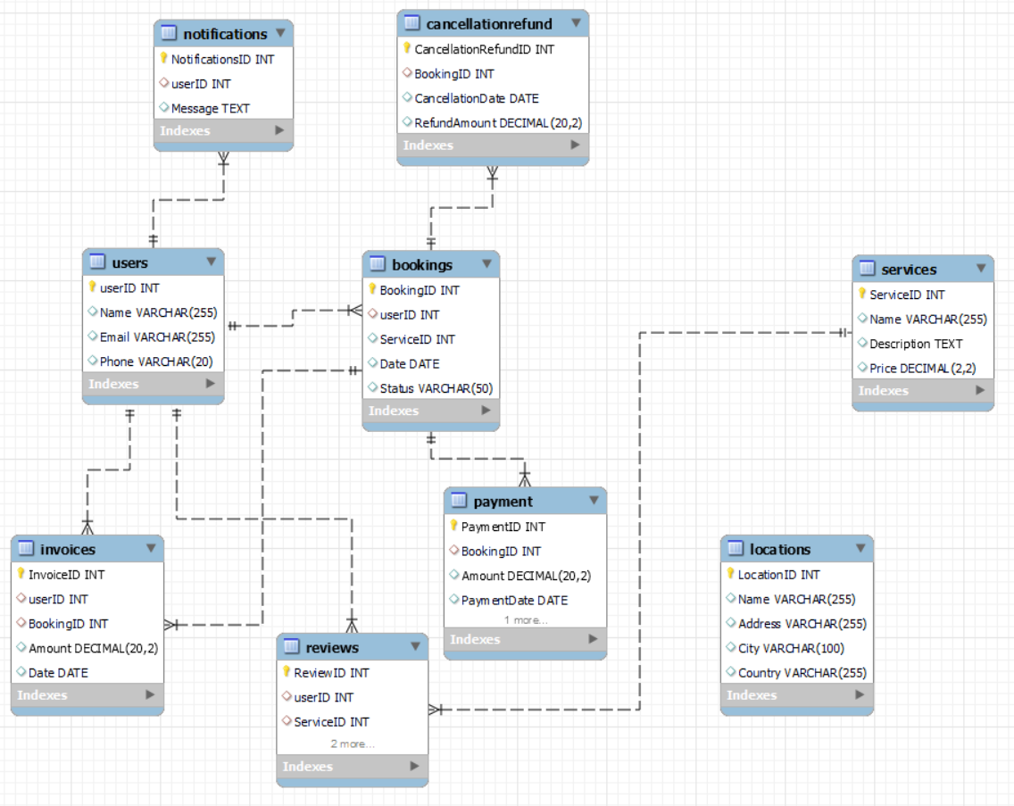
ER Diagram

Slide 15




Empowering Managers and Administrators
User Management
Invoice Generation
Reporting and Analytics
Cancellation and Refund
Secure user registration, login, and profile management features enable efficient user onboarding and account management.
Automatic invoice generation and storage for completed bookings simplifies financial record-keeping and customer communication.
Comprehensive reporting and analytics tools provide valuable insights into booking trends, user behavior, and service performance.
Streamlined processes for handling cancellations and refunds ensure a smooth and transparent experience for both users and managers.

Slide 16
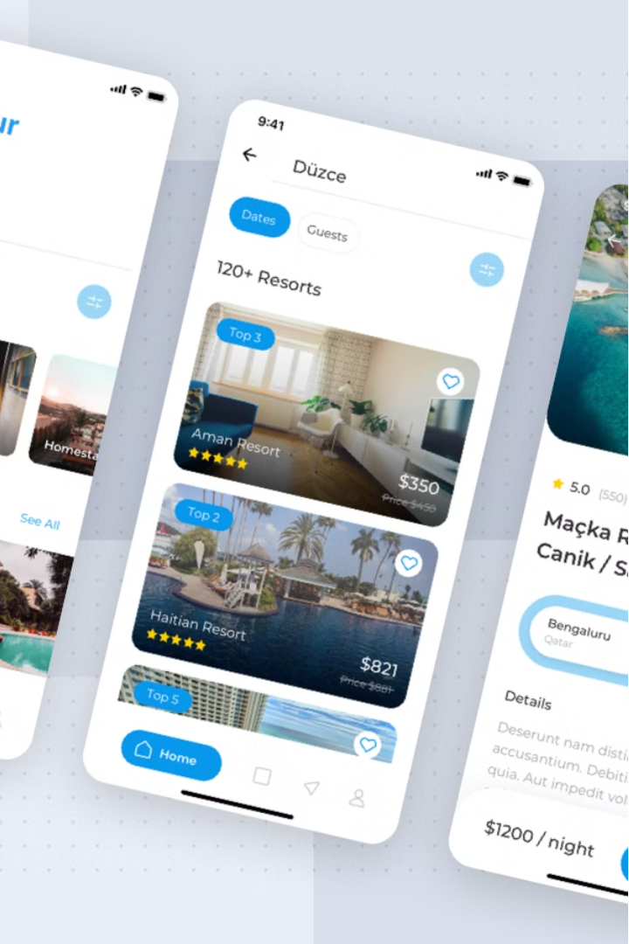
Conclusion
Designing an effective ER diagram is a crucial step in developing a robust booking and reservation system. By carefully defining the entities, attributes, and relationships, you can create a flexible and scalable platform that caters to the needs of both users and service providers. The ER diagram outlined in this article provides a solid foundation for building a comprehensive booking and reservation system, with features that enhance the user experience, empower managers, and streamline the overall booking and reservation process.

